Slide 1
README
BURN AFTER READING
about_SlideDeck
The actual presentation starts with slide 6 ("Session title"). The first five slides have a purely organisational purpose. During the break before your session, you should start the presentation with slide 2 ("Next up"), so that the audience knows that they are in the right room. It's fine if you start chatting with the audience during this break, but we need a precise starting point for your presentation in terms of editing your video. That means:
The recording of your presentation will start after the countdown. Please (RE)START talking after the countdown, not during it! Otherwise your recording will start with a half sentence.
It is not necessary to explicitly signal to the PA operator, this is your signal!
Finally, do you have to use this slide deck? No, you are free to present the way you like it. But you are asked to use the intro slides: countdown, session title, sponsor slide. Beyond that, use what is good for the cause – from no slides to sketches from your children, from Jupyter to $youNameIt.
You will find additional information in the notes below.
Sincerely, your hosts!
Dear Speaker, we are thrilled and honored to have you with us in Antwerp in 2024. Take your time and read this before you prepare your session.
Since most of you have been with us before, you will already know a lot about PSConfEU. You know that we try to capture all sessions carefully and publish your work on YouTube. There are a few easily avoidable stumbling blocks that we would like to draw your attention to:
Your screen resolution should be 1920x1080 px (FullHD)
You should provide a full size HDMI socket
Mirror your screen
Disable "Presenter View" in PowerPoint
Using MAC or Surface book? Be aware of HDCP!
Notes:
The fine print (additional information)
Why should you care about HDCP?
"High-bandwidth Digital Content Protection (HDCP) is a form of digital copy protection developed by Intel Corporation to prevent copying of digital audio and video content as it travels across connections. Types of connections include DisplayPort (DP), Digital Visual Interface (DVI), and High-Definition Multimedia Interface (HDMI), as well as less popular or now deprecated protocols like Gigabit Video Interface (GVIF) and Unified Display Interface (UDI)."
https://en.wikipedia.org/wiki/High-bandwidth_Digital_Content_Protection
Some notebooks ignore the HDCP standard, some vendors comply with the standard. Apple and Microsoft are somehow famous for strictly following the HDCP guidelines. Sadly, we will not be able to guarantee, that your session can be recorded in the latter case.
But you can do simple things, to overcome these problems. It is also very likely that you presented with your notebook before. So you will know, if this worked fine.If you are in doubt and if the agenda allows, try a dry-run a day before and connect everything.
In general you can easily bypass HDCP restrictions with a cheap splitter (the cheaper the better), just like the one you see below. This is an example device that we bought for 16 euros (in Germany).
Ask us, we will lend you such a device.
Thorsten also gave a whole presentation about "Broadcasting yourself" - easy steps to record yourself and create a (backup) session recording on your own. If you want to invest your time and dive deeper, take a look at his recordings and notes:
https://vimeo.com/thorstenbutz/byourself
This is of course completely voluntary, but perhaps you will find it helpful.

Slide 2
Next Up: Hitchhiker's Guide to Multitenant environments
David Sass

Slide 3
3
3

Slide 4
2

Slide 5
1

Slide 6
Hitchhiker's Guide to Multitenant environments
David Sass

Slide 7

Many thanks to our sponsors:

Slide 8
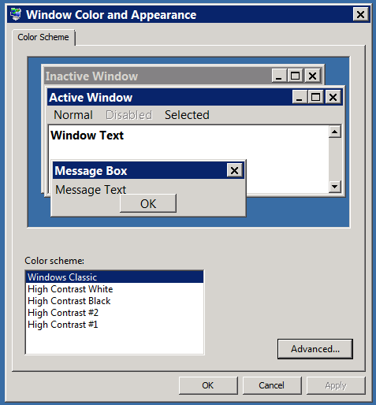
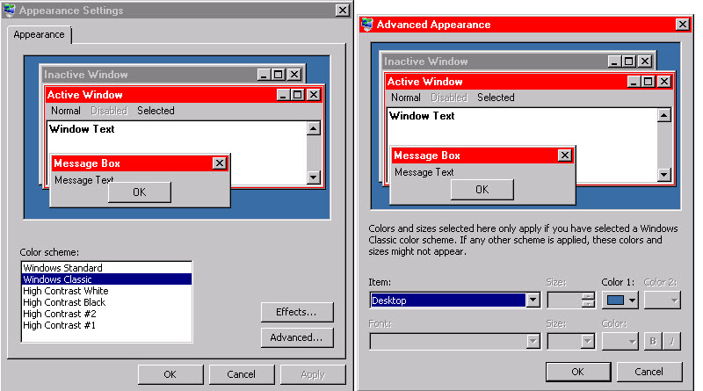
The good old days

Slide 9
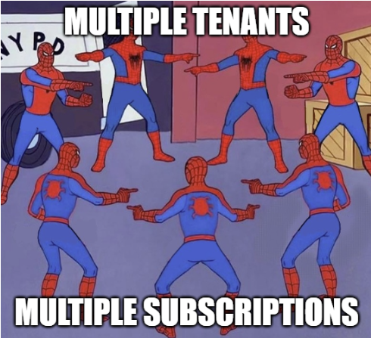
Multitenant chaos

Slide 10
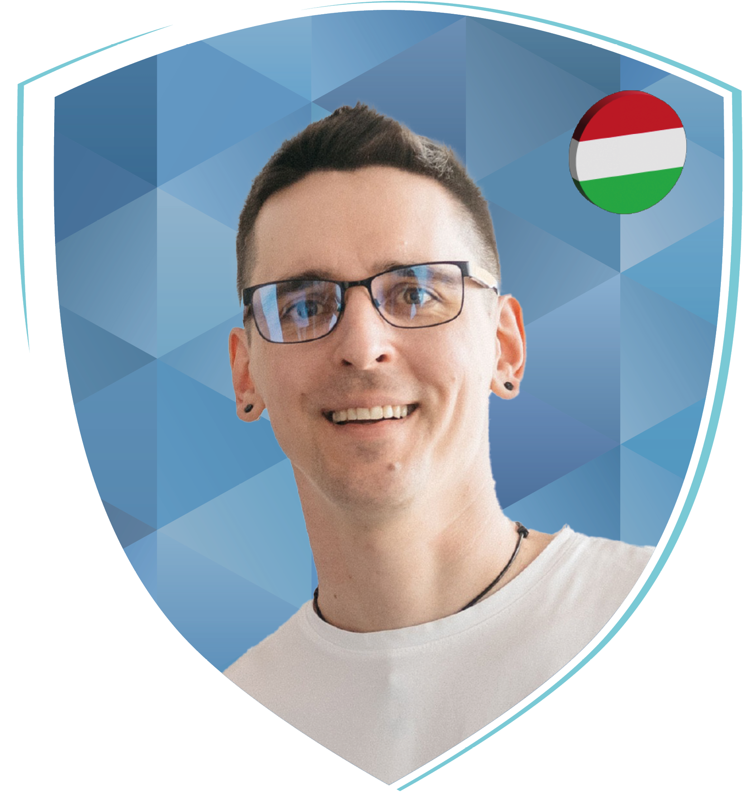
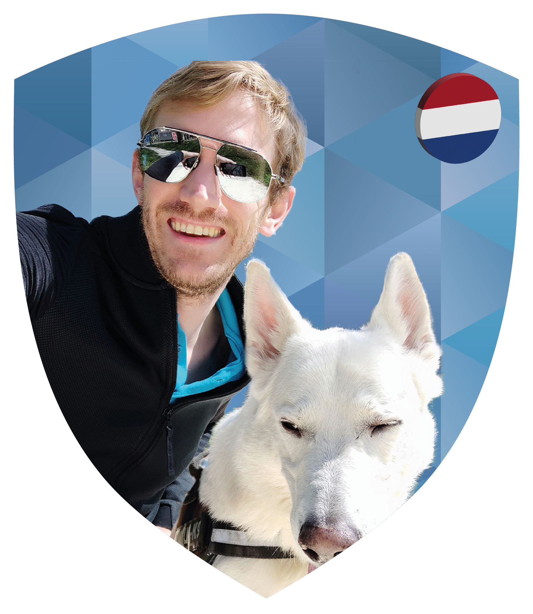
David Sass
Security Engineer at Switch
Former SRE
Recovering SharePoint Architect
Still dreams about Kerberos
Screams at the cloud
Relationship with Git is complicated
Will tell you Notebooks are awesome
dah-vEEd Schass
He/him/his/Skills

Slide 11
Different levels of Multi-*
Single subscription, multiple resource groups
Multiple subscriptions but single tenant
Multiple subscriptions multiple tenants

Slide 12
What can we do?
Customize the PowerShell profile
Customize the Windows Terminal profile
Customize the prompt with oh-my-posh
Customize oh-my-posh
Create always visible visual guardrails
Prevent Context sharing / reuse between sessions

Slide 13
Demos
We love Demos!

Slide 14
Resources
Ohmyposh – Theme (coming soon)
PowerShell sample (github.com/psconfeu/2024)

Slide 15
Q&A
15 minutes

